Slide 1
Introduction to HTML

Slide 2
HTML Hyper Text Markup Language
• HTML is a formatting language used to develop web pages.
• HTML language tells a Web Browser how to format/represent the document i.e. where to put text, how big to make the words, where to place pictures etc.
• HTML is not a programming language .i.e. it does not have variable declaration, decision control structure and loop.
• But, HTML is a language; as it has certain rule about formatting the contents of a web page.
• HTML uses tags or markups to specify that how the contents of a web page will be displayed.

Slide 3
Benefits of HTML
Simplicity:
HTML is a simple language. Any person can use HTML easily to create web pages.
Platform Independent:
HTML works on any platform (OS, Hardware).
HTML is text based language. Therefore HTML document created for one type platform can be used on different type of platform.
Easy Navigation:
HTML web pages are linked together using hyperlinks.
It provides easy navigation form one page to another page.
Attractive and Easier to Read:
HTML allows the use of graphics and animation.
It delivers richer contents and arranges the content creatively.

Slide 4
Limitation of HTML
No Programming Capabilities:
HTML provides no programming capabilities.
It only provides formatted text, pictures and sounds etc.
Static:
HTML can only be used to create static web pages.

Slide 5
Creation of HTML Document
HTML document is a file that contains tags and information (text, pictures) to be formatted. HTML file will have extension either .HTM or .HTML.
The basic requirements to create HTML documents are:
Text Editor:
Text editor is used to write HTML commands (tags).
Any simple text editor like Notepad or Wordpad can be used for this purpose.
Web Browser:
Web browser is used to test web pages.
Any web browser like Internet Explorer, Netscape Communicator can be used for this purpose.

Slide 6
Basic Structure of a HTML Document
• HTML document starts with <HTML> and ends with </HTML> tags.
• HTML documents has TWO sections:
Head Section:
Head section contains tags that has some control information.
<HTML>
<HEAD>
<TITLE>
The text between <TITLE> and </TITLE> tags is displayed at the title bar of the browser.
Body Section:
Body section contains the actual information (text, graphics) that is to be displayed in the display are of the browser.
It also contains the tags for formatting the text to be displayed.

Slide 7
Basic Structure of a HTML Document
<html>
<TITLE> some text for title</TITLE>
<HEAD> </HEAD>
<BODY>
---------
---------
---------
---------
---------
</BODY>
</HTML>

Slide 8
Tags, elements and Attributes
HTML uses tags or markups to specify that how the contents of a web page will be displayed.
A HTML tag is started with character “<“ followed by an element and ends with character “>”.
These characters are called angle brackets.

Slide 9
Tags, elements and Attributes
An element is a word that instructs to the browser that how to format the content of the page coming after.
Example : <B>BS-CS</B>
Element is surrounded by angle brackets.

Slide 10
Tags, elements and Attributes
Attributes are the additional information about the element that is included with the element inside the angle brackets.
Some attributes are optional whereas come are compulsory.
Example : <BODY BGCOLOR = “red”>
<TABLE ALIGN = “center” >,
<IMG SOURCE = “C:\\pictures\abc.jpg”>

Slide 11
Tags
HTML tags can be written in both uppercase and lowercase.
HTML tags can be nested and can be opened and closed in any order.
HTML tag effects the contents coming between the opening and closing tags.
The closing tag has the same element name but preceded by “/”.
If a closing tag is missing, the browser will not report an error but the page will not be displayed as expected.

Slide 12
Tags
A HTML tag will be either single or paired tag:
Single Tag:
A tag that has only the opening tag but does not have the closing tag.
Example : <HR>, <BR> etc.
Paired Tag:
A tag that has the opening as well as the closing tag.
Example : <BODY>----Some Text----</BODY>
Example : <B><I>BS-CS</B></I>

Slide 13
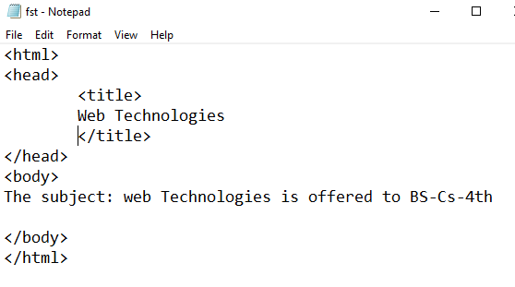
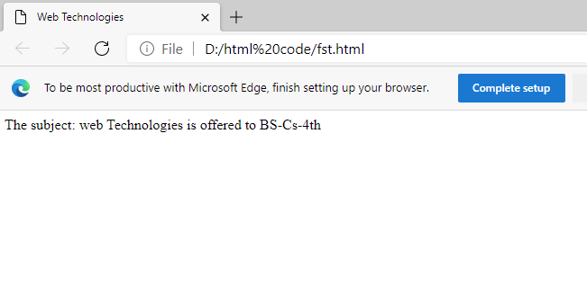
Example

Slide 14
<BODY> Tag
<BODY> ---- </BODY> tag contains the actual informations to be displayed in the display area of the browser.
<BODY> has some attributes that will effect the whole document:
BGCOLOR:
Specifies the background color of the web page.
BACKGROUND:
Specifies the background picture of the web page.
TEXT:
Specifies the color of text to be displayed in the web page.

Slide 15
Headings
Headings are used to display different types of headings in the <BODY> tag of HTML document.
The opening tag for heading tag is <Hn> and the closing tag is </Hn> where n is the size of heading and its value can be from 1 to 6.
The value 1 represents the largest and the value 6 represents the smallest heading size.
Headings tag has an attribute:
ALIGN:
Specifies the alignment of the heading. The possible values can be center, left and right. The value left is by default.

Slide 16
Paragraphs <P> Tag
<P> adds text to a document in such away that it will automatically adjust the end of the lines to suit the window size of the browser.
Text to be displayed is written between <P> and </P> tags.
<P> tag also add and extra balnk line before and after the paragraph.
Attribute of <P> is:
ALIGN:
Specifies the alignment of the heading. The possible values can be center, left and right. The value left is by default.

Slide 17
Line Breaks <BR> Tag
• Line break is used to decide that where the text will break one a line or continue to the end of the window.
• Line break is used to break the current line and move the control to the next line.
• The <BR> tag is used to end a line and it is single tag (having no closing tag) and does not have any attribute.

Slide 18
Horizontal Line <HR> Tag
• Horizontal line <HR> tag is used to display a horizontal line in the page to separate different areas of a web page.
• <HR> is a single tag (having no closing tag).
• <HR> tag attributes are:
ALIGN:
Specifies the alignment of the heading. The possible values can be center, left and right. The value left is by default.
SIZE:
Specifies the size of the line in pixels. The default size is 2 pixels.
WIDTH:
Specifies the width of the line in either pixels or percentage. The width of the line is according to the width of the web page by default.
NOSHADE:
Turns off the shading of the line.
COLOR:
Specifies the color of the line.

Slide 19
Text Formatting Tags
Bold:
<B> tag is used to display text in bold face style.
Example : <B>Formatting make things cool.</B>
Italic:
<I> tag is used to display text in italic style.
Example : <I>Italic text looks stylish.</I>
Underline:
<U>tag is used to display text as underline.
Example: <U>Underline text look Prominent.</U>
Superscript:
<SUP> tag is used to display text as superscript.
Ex: X<SUP>3</<SUP>.
Subscript:
<SUB>tag is used to display text as subscript.
Example : H<SUB>2</SUB>O.

Slide 20
<STRONG> and <EM> Tags
• <STRONG>---</STRONG>
This tag is an alternative to <B>--</B> tag.
• <EM>---</EM>
This tag is an alternative to <I>--</I> tag.

Slide 21
<CENTER> Tag
• <CENTER>---</CENTER>
This tag is used to center everything found between them .i.e. Text, Image, Tables or any page element.

Slide 22
FONT<FONT> Tag
<FONT> tag is used to specify the font name, size and color of the text to be displayed.
Text to be displayed is between <FONT> and </FONT>.
<FONT> tag attributes are:
FACE:
Specifies the font of the text. Possible values are “Arial”, “Arial Black”, “Courier” etc.
SIZE:
Specifies font size of the text. It can be from 1 to 7. The default size is 3. The size 1 displays 8pt size, size 2 displays 10pt and so on.
COLOR:
Specifies the color of the text. Its value can either the color name or the hexadecimal value of the color.

Slide 23
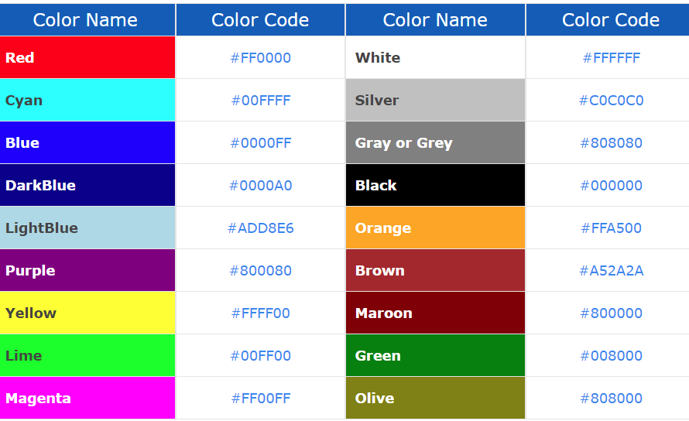
Color examples

Slide 24
Spaces and Character Entities
If an HTML document has many spaces between two words, additional spaces are removed automatically.
If the user inserts Five spaces between two characters, four of them will be removed automatically.
Example: If I write <B>Wed Technologies</B>
It will be displayed as Web Technologies
If I want more spaces, I will write it as
<B>web &nbsp; &nbsp; &nbsp; &nbsp; Technologies</B>
It will be displayed as Web Technologies
Therefore if additional spaces are required, character entity (&nbsp;) has to be used.

Slide 25
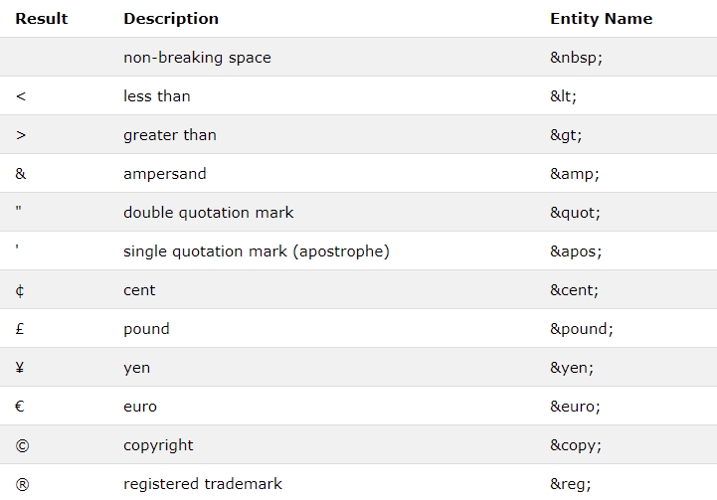
Some Useful HTML Character Entities

Slide 26
Preformatted Text <PRE> Tag
Web browser normally while executing the HTML stream back from the server ignores the carriage returns (enter) pressed by the developer during writing text in the web page.
The <pre> tag defines preformatted text.
Text in a <pre> element is displayed in a fixed-width font, and the text preserves both spaces and line breaks.
The text will be displayed exactly as written in the HTML source code.
The text to be displayed is written between <PRE> and </PRE> tags.

Slide 27
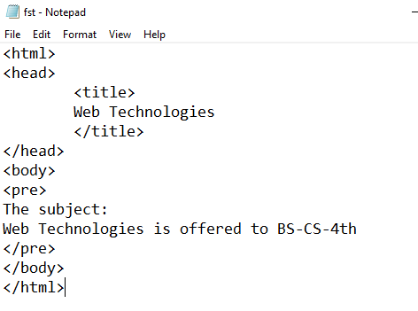
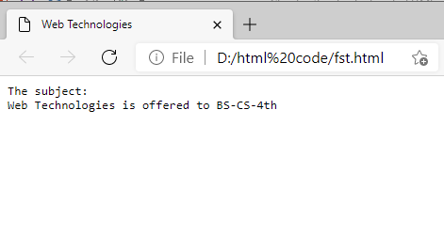
Preformatted Text <PRE> Tag

Slide 28
Lab-1
Develop a static Web page using HTML by applying all the tags and their attributes in todays lecture. The static page can be about anything of your interest.

